Slide 1







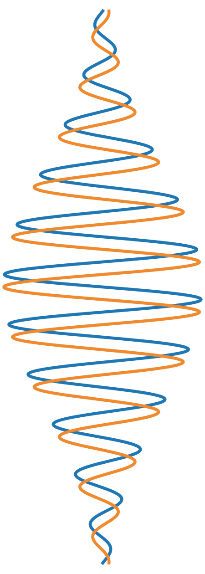

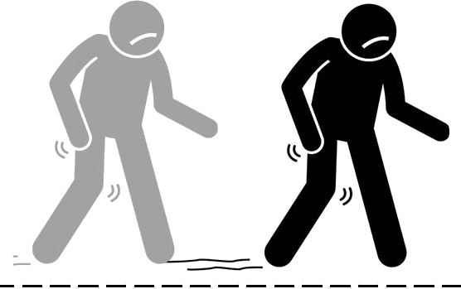

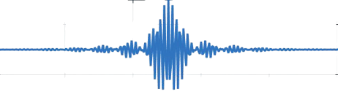
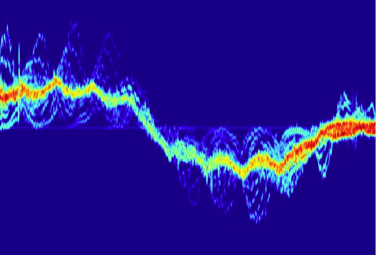


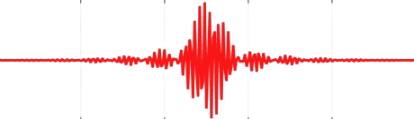



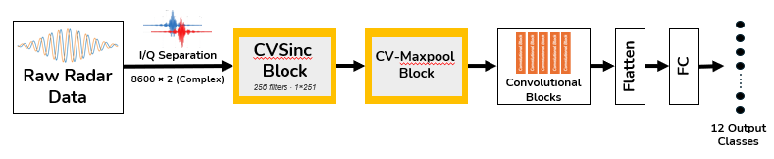
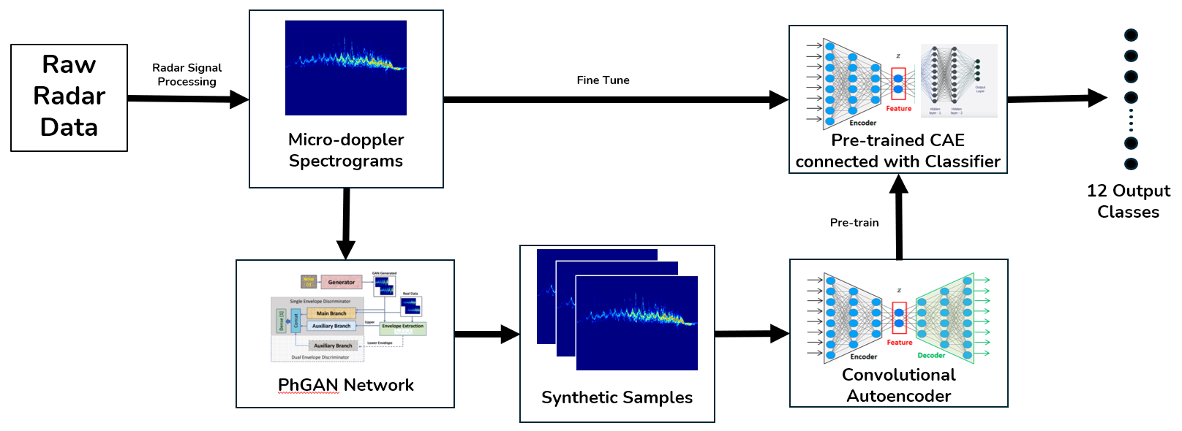

Physics-Aware Machine Learning for Real-World Human Activity Recognition
POSTER 2.2
THEME 2
PI: Dr. Sevgi Z. Gurbuz
Kamrul Islam, Sultanus Salehin
Department of Electrical & Computer Engineering, North Carolina State University
Motivation
GRAPHICAL ABSTRACT
Two Roadblocks, Two Physics-Aware Answers
A rescue team at a collapsed structure has two time-sensitive questions: is anyone alive inside, and can they get out on their own?
OBJECTIVE
Recognise activity, gait and injury through dust and debris, accurately enough to answer both and light enough to run at the edge.
DEVELOPED SOLUTIONS
▪ CV-SincNet - direct classification from the raw complex signal.
▪ PhGAN - physics-constrained synthetic training data.
Major Roadblocks
Limping — injured
Pre- Processing
Data insufficiency
Power and Computational Cost in Data Pre-processing
Walking with cane
CV-SincNet bypasses the processing bottleneck. It learns band-pass filters on the complex raw signal, and every filter is a velocity band, so no spectrogram is ever formed.
PhGAN solves the data shortage. It synthesises new training samples from a small pool of real data, with envelope constraints keeping them kinematically real.
Idle — immobile
Radar rover
Collapsed structure- zoomed in
77 GHz FMCW
Survivors found and classified
Radar sees through dust and debris without needing light or invading private spaces.
12 activity classes (9 gaits, 3 in-place) · 6 participants · 77 GHz FMCW radar
IMPACT? Builds the physics of the measurement into the model, cutting our reliance on massive datasets.
Physics-Aware Models · Architecture and Benchmarking
CV-SincNet · learn the filter, never draw the picture
PhGAN + CAE · more data without breaking the physics
PERFORMANCE vs STATE OF THE ART
92%
overall accuracy
PhGAN pipeline vs 82% (ViT-B/16)
No pre-processing cost: the network takes the I/Q stream directly, 8600 × 2 complex samples per window.
0.54 M parameters and about 1 s end to end on Intel Core Ultra 5 / Ultra 7, light enough for real-time edge processing.
>20×
faster pre-processing
CV-SincNet · no spectrogram formed
The discriminator checks the upper and lower envelopes, so a synthetic sample must be physically plausible to count as real.
A convolutional autoencoder pre-trains on them, then fine-tunes on a small pool of real data.
36×
fewer parameters
2.4 M vs 85.8 M (ViT-B/16)
IMPACT? The pre-processing bottleneck disappears, over 20× faster than spectrogram-based pipelines.
IMPACT? 92% accuracy with only 2.4 M parameters, learned from a small pool of real data.

